Slide 1



Customer Churn
View in Power BI
Last data refresh:
30/12/2022 18:03:43 UTC
Downloaded at:
30/12/2022 18:08:30 UTC

Slide 2
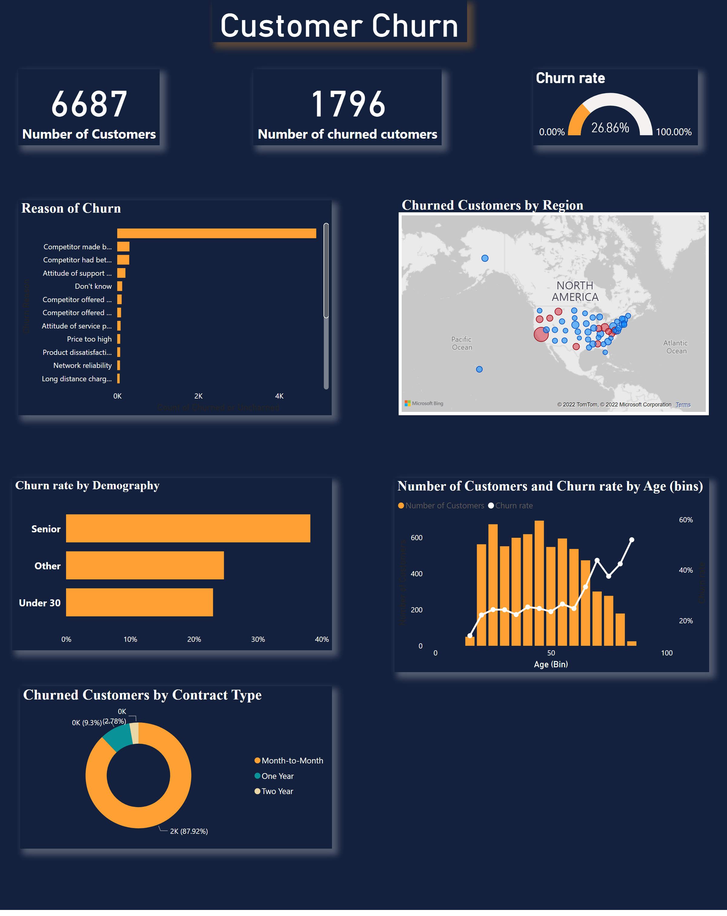
Dashboard
Notes:
card
No alt text provided
card
No alt text provided
Churned Customers by Region
No alt text provided
Reason of Churn
No alt text provided
lineStackedColumnComboChart
No alt text provided
gauge
No alt text provided
Churn rate by Demography
No alt text provided
Churned Customers by Contract Type
No alt text provided
card
No alt text provided

